Slide 1


Headline Verdana Bold
Mortgage Cross Selling Case Study
Building Insights to Cross- Sell Insurance Products
Nikhil Mehrotra
04.10-2020

Slide 2

Agenda
About Business Case 3
Breaking down the Case 4
Data Identification & Validation 5
Whom to Cross Sell 15
What to Cross Sell 18
Appendix 21

Slide 3
About Business Case
Why
Business struggles with -:
Keeping track of customers to offer a PPI product & which type of PPI to offer
Need for an Early Identification System that can shortlist customers eligible for Cross Sell Campaign
Identifying an Engagement Metrics that can help in evaluating a Cross Sell Campaign
What
Business needs -:
All important variables which can drive PPI purchase and MIS reporting around it
Association rules which can highlight the hidden patterns around customer purchase behavior
How
We have to build -:
Insights around all business variables in order to identify top most features that drive PPI purchase
Mine out segments within the important features to identify target audience
Use association rules to cross sell right product to right customer segment

Slide 4
Breaking down the Case
How we build insights around identifying the right customer to Cross Sell Insurance Products?
Cleanse the data for the data analysis – Removing NAs / -VE values flowing in various columns.
1
Data identification
2
Perform full Exploratory data Analysis
Transform variables to handle skewness and build segments
Identifying important variables that can impact PPI purchase
Identify the relationship between different predictor variables and predicted variable
Data Validation
Understand data from all relevant files
Loading all the variables into R environment.
3
Data Exploration
4
Data Analysis
Building a model that can help in identifying important features which can help in understanding the Cross Selling readiness of a consumer.
Selecting algorithm which helps in building rules around shortlisted important variables and PPI/ PPI types.
New patterns

Slide 5
Data Validation
Data Identification
In the Insurance Data set, we have 59 Columns and 16,383 records. Some important observations -:
Column Ref has been assumed as Customer-id as it is a unique field
All Customers have purchased either a secured or unsecured Loan
PPI Column denotes if a customer has purchased an insurance product or not.
A Data dictionary has been created for this dataset and has been appended in the appendix section
.
Checking for Duplicates
Imputing -VE/Missing Values
Cleaning –up Insurance Description
Converting Variables to Factor
The shared Data Structure has 16,383 records and 59 feature
No duplicate record found at “Ref” column level
3 features had missing values and 12 features had “-1”
NA values have been in descriptive columns such as Insurance Description, Category and Code. It has been imputed by “No Insurance & 0 respectively
-VE values have been imputed by mean values in all 12 columns. There were around 8 such records
Insurance Description column had 22 different products. Couple of them were same due to typo. Finally 20 different Insurance products are available. Also, this column has been converted to lowercase
29 Categorical and Binary variables have been converted into factor.

Slide 6
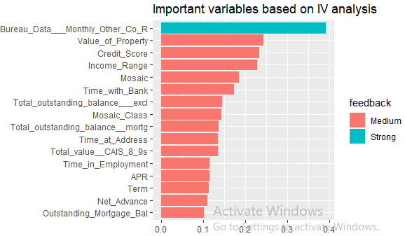

Exploring the Data Set
Identifying the most important features w.r.t PPI Sale
Since we have 58 columns to explore and understand their relationship with PPI, we started with identifying the most important variables (among them) that can have a deep impact with Insurance product purchase behavior.
Approach Used -: Information Value & Weight of Evidence
a. Helps in handling outliers/ missing values as we can transform each variable with their corresponding WOE value
b. Identifies important variables which have significant relationship with PPI purchase. I have shortlisted strong and medium ones only
c. Helps in segmenting all the variables – Categorical or Continuous, in ideal no. of bins

Slide 7
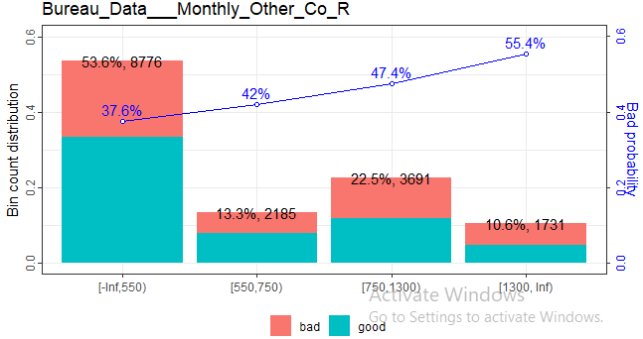
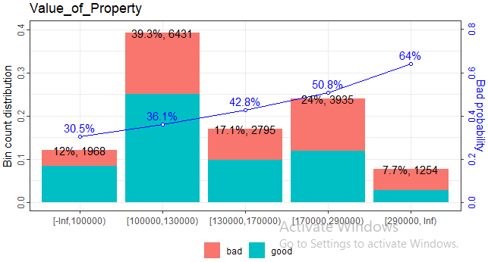
Exploring the Data Set
1. Bureau Data Monthly Other Co_R
More than half of the loan customers fall under <550 segment whereas 22.5% customers are from the segment 750-1299 (the second best)
The same slab has the highest no. PPI Cross Selling followed by segment 750-1299 whereas cross sell rate is second best in the segment 550-749
2. Value of Property
Highest no. of loan customers are from segment 1lac-1.3 lac (as value of the property being put as collateral against the loan)
Insurance cross sell rate has been the highest in the slab <1 lac segment but in absolute terms, 1lac-1.3 lac segment ranks the best

Slide 8
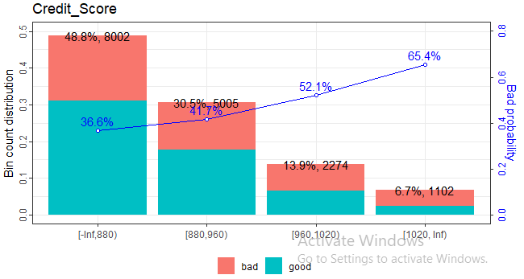
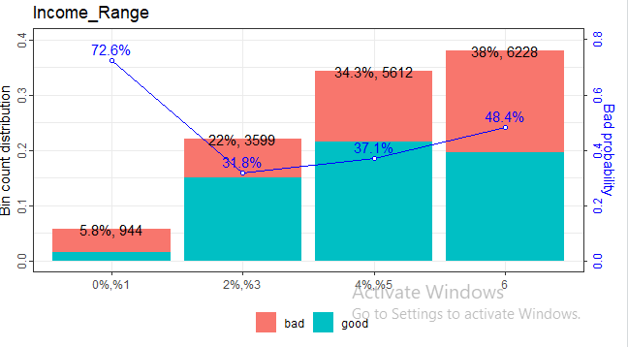
Exploring the Data Set
3. Credit Score
352-960 forms the major band in terms of loan consumer with almost 80 % of them coming from this segment
Also, major cross selling has taken place in these two segments
4. Income Range
94 % of loan consumer are in income range 2 and above
In absolute terms, maximum no. of cross selling has happened in segment 4-5 followed by 6 whereas in % terms 2-3 segment has the highest cross sell cases (68.2%)

Slide 9
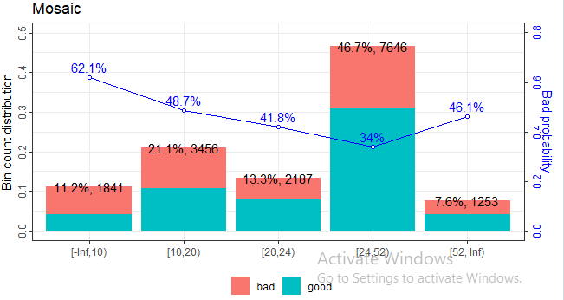
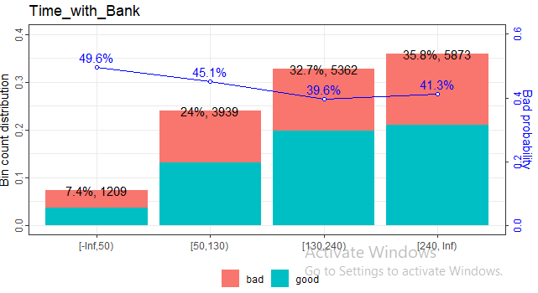
Exploring the Data Set
5. Mosaic
In terms of Mosaic Customer Segmentation, segment group 24-52 has the maximum no. of loan consumers and also the highest cross selling Rate
6. Time with Bank
From the trend below, it is clear that as the relationship with customer becomes older, probability of cross sell increases.
Majority of loan consumers are also old customers. Thus, bank commands a strong loyal base.

Slide 10
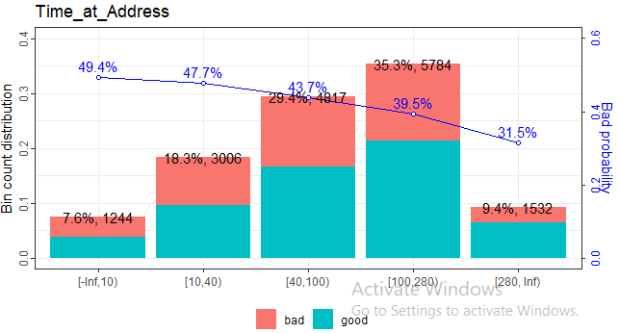
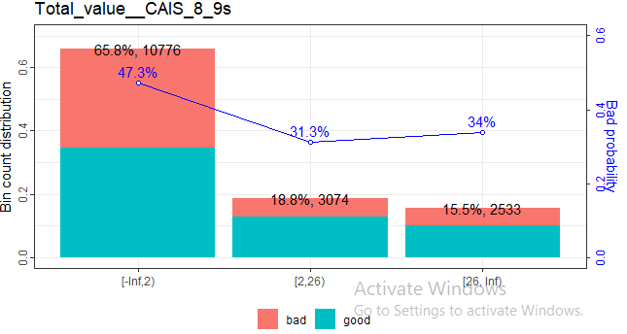
Exploring the Data Set
7. Time at Address
Majority of loan consumers have spent at least a year at their current address. Consumers staying for 3 or more years form the core of this population
Cross Selling rate is highest in the segment having maximum no. of months at the same address
8. Total value CAIS_8_9s
Majority of loan consumers fall under the segment <2 but probability of cross sell is almost half here
Cross Selling % is highest in the segment 2 and above

Slide 11
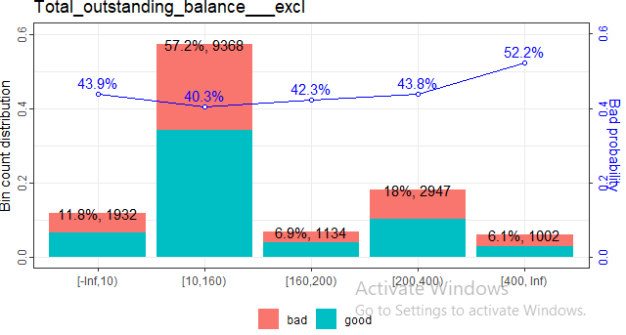
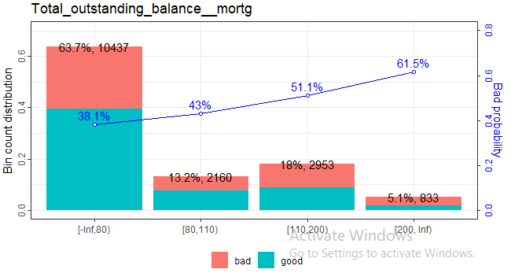
Exploring the Data Set
9. Total Outstanding Balance_Excl
Loan Consumer Segment ,having total outstanding balance between 10-159, also have the highest Cross Selling rate.
10. Total Outstanding Balance_ Mortg
Cross Selling rate is highest for the Consumer Segment having Outstanding Mortgage balance between 0-79. As the mortgage balance increase, thereafter, Cross Selling opportunities decreases.

Slide 12
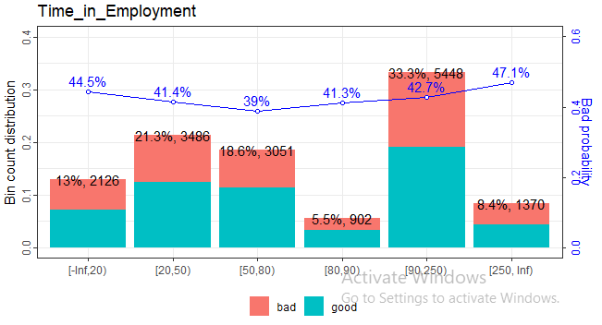
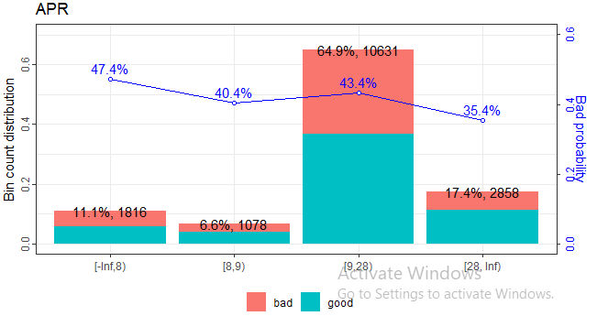
Exploring the Data Set
11. Time in Employment
Cross selling opportunities ( in absolute terms) have been highest with consumers who have 7-20 years of employment.
Segment 4- 6 years of employment offers the highest Cross Selling rate.
12. APR
Clearly, majority of PPI cross selling opportunities are coming from consumers having APR between 9-28

Slide 13
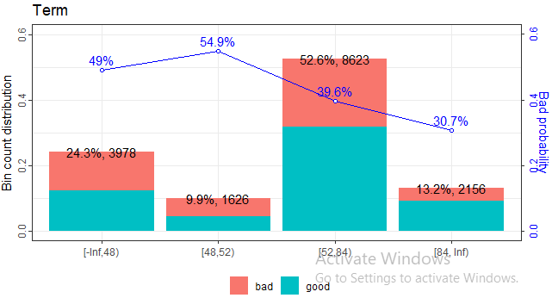
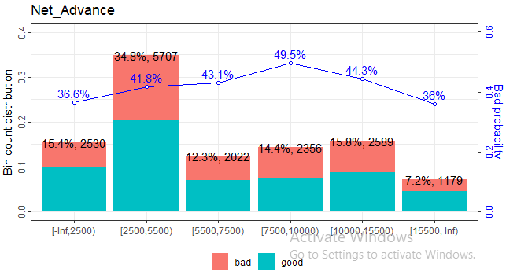
Exploring the Data Set
13. Term
Consumers, who are having loan term for 52 -84 months, have the highest number of PPI conversions. The conversion % further improves with consumers having long term loans
14. Net Advance
Consumers with Net Advance in segment 2500-5499 have the highest number of PPI conversions but cross sell rate is highest in segments <2500 and > 15500

Slide 14
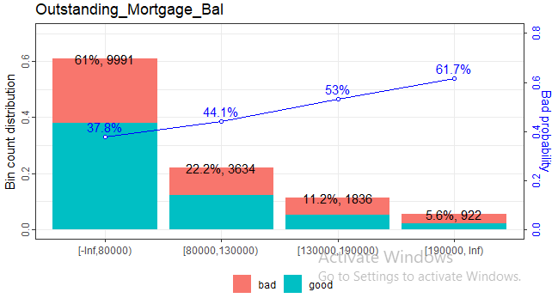
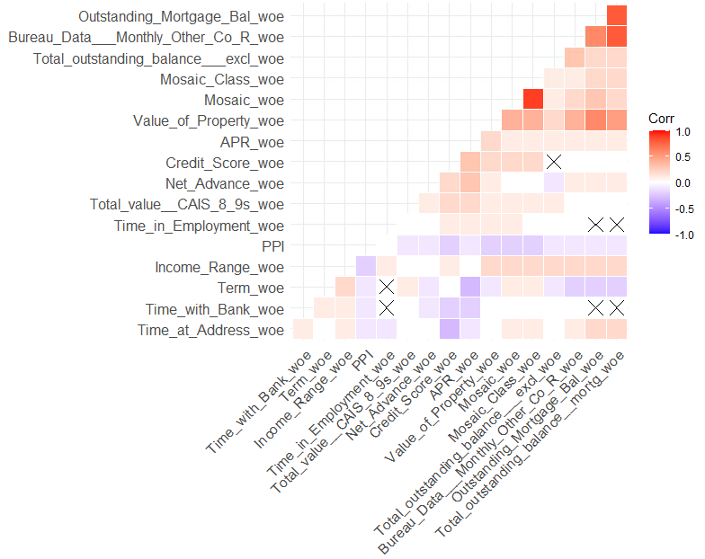
Exploring the Data Set
15. Outstanding Mortgage Balance
As the outstanding mortgage balance increases, probability of PPI cross sell decreases . Bulk of cross sells happens with consumers having outstanding mortgage balance <80000
Correlation Plot between Important Variables

Slide 15
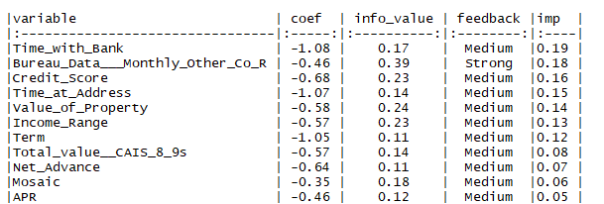
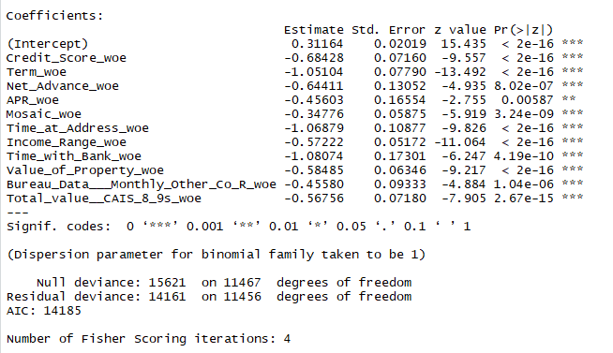
Whom to Cross Sell
Measuring Cross Sell Readiness through Binary Classification modelling
Based upon the output of EDA & IV analysis, we have shortlisted 16 variables (with “Strong” or “Medium” IV) for the modelling process.
Approach Used -: Logistic Regression on WOE transformed data set
a. Using WOE transformed data set helped in handling outliers, binning features based upon target variable value and normalizing the distribution
b. We have used Scorecard Package for building WOE transformed data set, model building & evaluation and Scorecard generation
c. Model with minimum AIC and no multi-collinearity was selected in the end after multiple iterations with the initial 16 variables
Variable Importance Table
Model Output
Coefficients of the final model are –ve as they are derived from WOE transformed data set. In order to interpret the results and identify the most important predictors, we have multiplied the absolute value of coefficient of a feature with its IV as just considering “coef” and p-value will not give the accurate picture

Slide 16


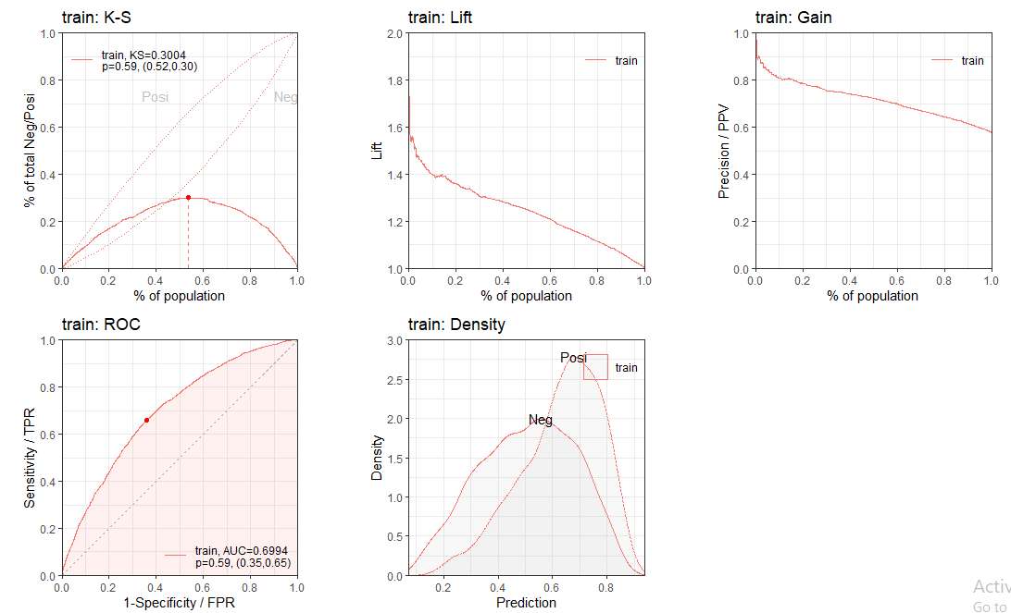
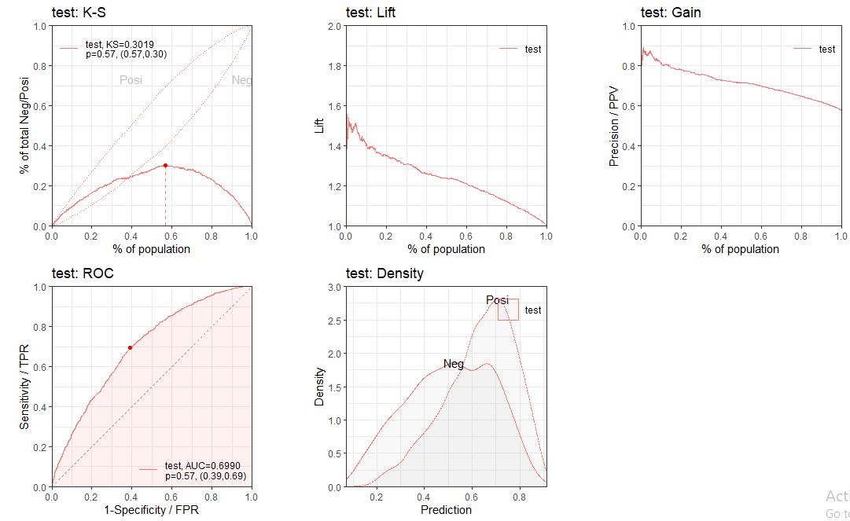
Whom to Cross Sell
Model Evaluation Statistics
Overall, the model delivered an accuracy of 65% on both Train/Test data. Also, Sensitivity /Specificity stands around 65% and 64% respectively. Clearly, the model is not over-fitting but the accuracy can be improved by trying more complex algorithms which will minimize the bias present in the existing model but we have to be cautious in terms of over fitting with such models.

Slide 17
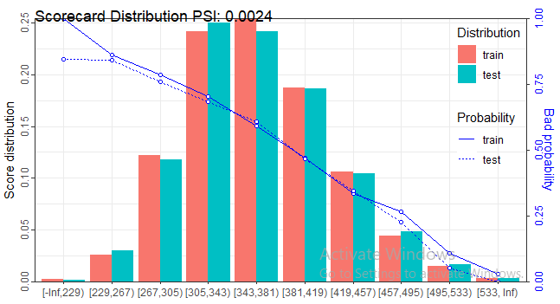
Whom to Cross Sell
Scored Card Distribution
The interpretation of the below mentioned scorecard distribution is inverse in nature as Scorecard package is designed to identify “1” as bad/Defaulter but in our case , we are predicting probability of cross sell and “1” is an indicator of successful “Cross Sell”. Therefore, as the score increases, probability of Cross Sell decreases.
Probability of Cross Sell is above 0.60 for score range 380 and below .

Slide 18
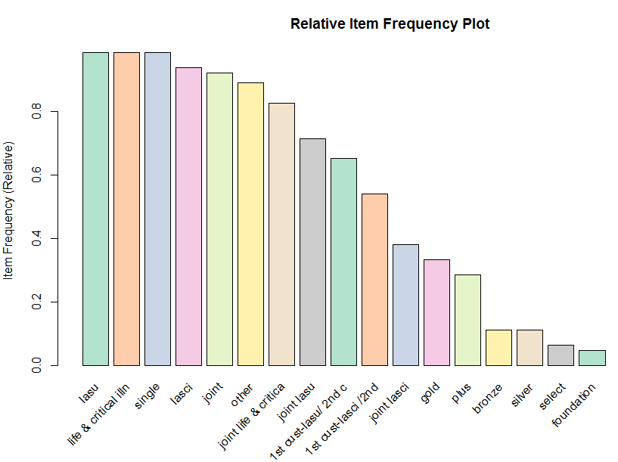
What to Cross Sell
Identifying Association Rules for Up-Sell/Cross Sell based upon Products purchased by Customers
Rule-based methodology can offer us insights around -:
Which Insurance “Product Types” we can Cross Sell/Up-sell based upon the consumer purchase history.
Which rule can offer maximum lift in comparison with other rules and what is the NAB (Next Best Alternative)
Insurance data set is unique at “Ref” column and we do not have any other Id field in the data set. So, in order to generate rules-
We will use column “Mosaic” ( Which is also a significant variable in terms of predicting the probability of PPI purchase,) as it is widely used in the US as a Demographic- Social Customer Segmentation indicator, and Column “Insurance Description” as inputs to the Apriori Algorithm (for Data Mining).
As parameter to the Apriori Algorithm, we have selected-:
Support = 0.001
Confidence = 0.75
Minlen =2
.
Product Frequency Plot
Key Insights
LASU, Life & Critical illness and Single are the most popular Insurance product types.
398 rules were generated by using Apriori Algorithm
Rule -{Foundation, Joint LASCI}=> {Bronze} offers the maximum level of Association.(Lift (9) with confidence of 100 %)
It can be interpreted as - Consumers in “Mosaic” group ,which purchases Foundation & Joint LASCI PPI , are 9 times more likely to buy Bronze PPI

Slide 19
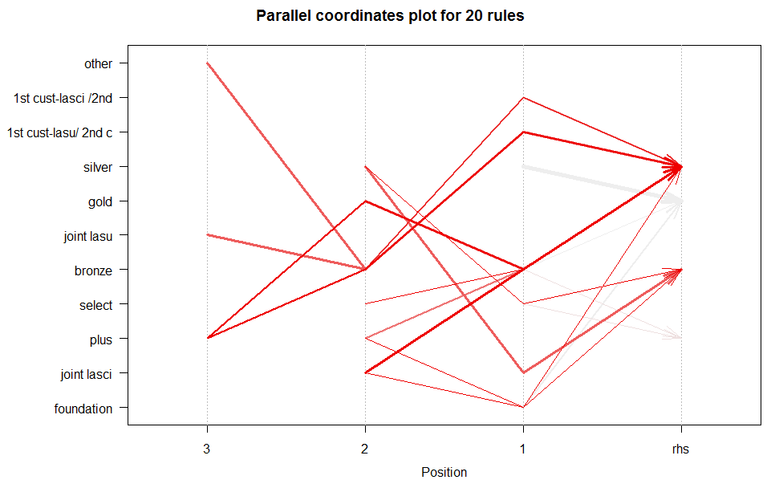
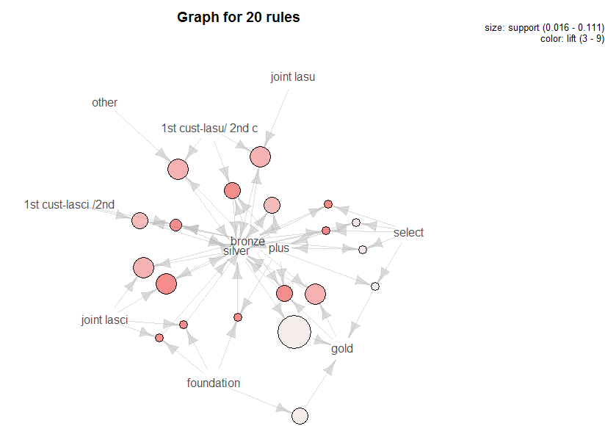
What to Cross Sell
Identifying Association Rules for Up-Sell/Cross Sell based upon Products purchased by Customers
Parallel Co-ordinate Plot for Top 20 Rules
Graph Plot for Top 20 Rules
Clearly, within the Top 20 Association rules, most of our transaction were concentrated around “Bronze” & “Silver” and Plus PPI. Also, Silver => Gold Association has the highest support level but does not offer a higher lift.

Slide 20
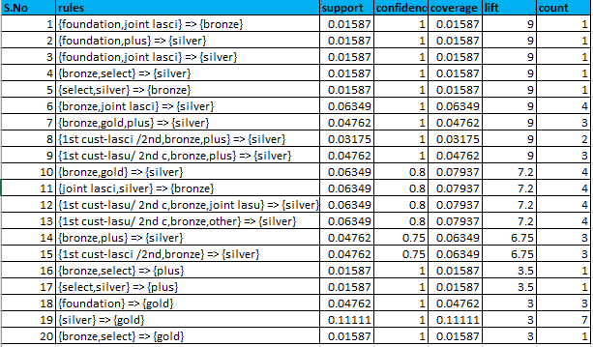
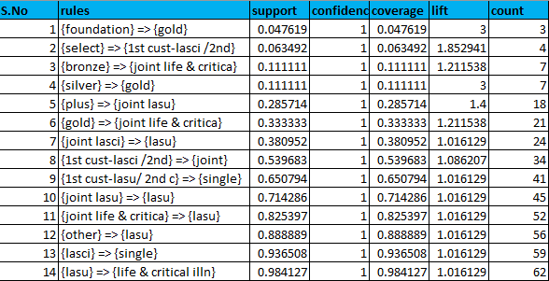
What to Cross Sell
Identifying Association Rules for Up-Sell/Cross Sell based upon Products purchased by Customers
Top Associations (Sorted by Lift)
Top Single Associations (Sorted by Confidence)
Some of the Popular Associations
Consumers in Mosaic groups ,which purchases Foundation PPI ,are 3 times more likely to buy Gold PPI
Consumers in Mosaic groups ,which purchases Silver PPI ,are 3 times more likely to buy Gold PPI
Consumers in Mosaic groups ,which purchases Gold PPI ,are 1.2 times more likely to buy Joint Life & Critical PPI
Consumers in Mosaic groups ,which purchases Bronze & Gold PPI ,are 7 times more likely to buy Silver PPI
Consumers with LASU PPI , the most popular PPI product present in all 62 Mosaic groups, have an equal affinity to purchase Life & Critical Illness PPI

Slide 21
APPENDIX

Slide 22
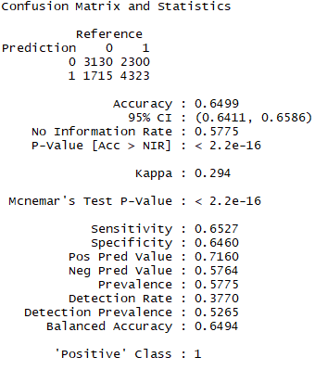
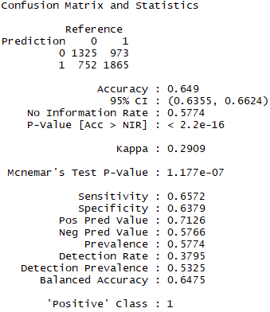
Data Analysis
Model Evaluation Statistics ( Confusion Matrix)

